Slide 1
Docker
Notes:
So what is .NET?

Slide 2
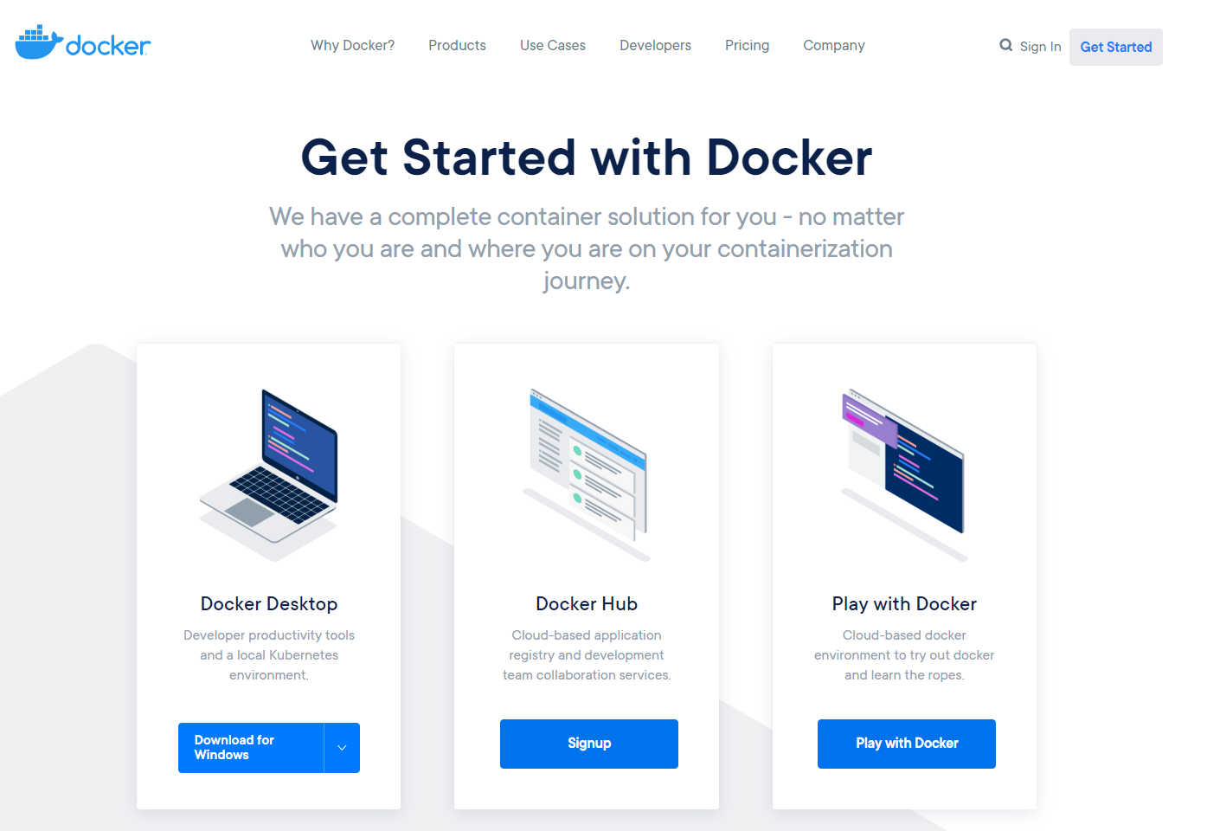

Slide 3
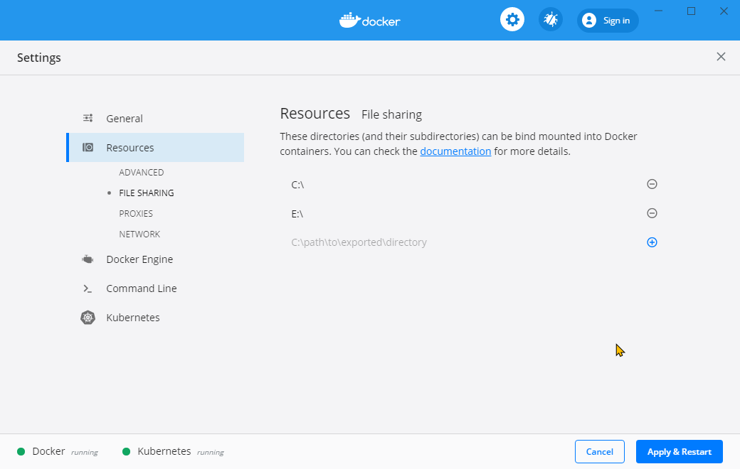

Slide 4
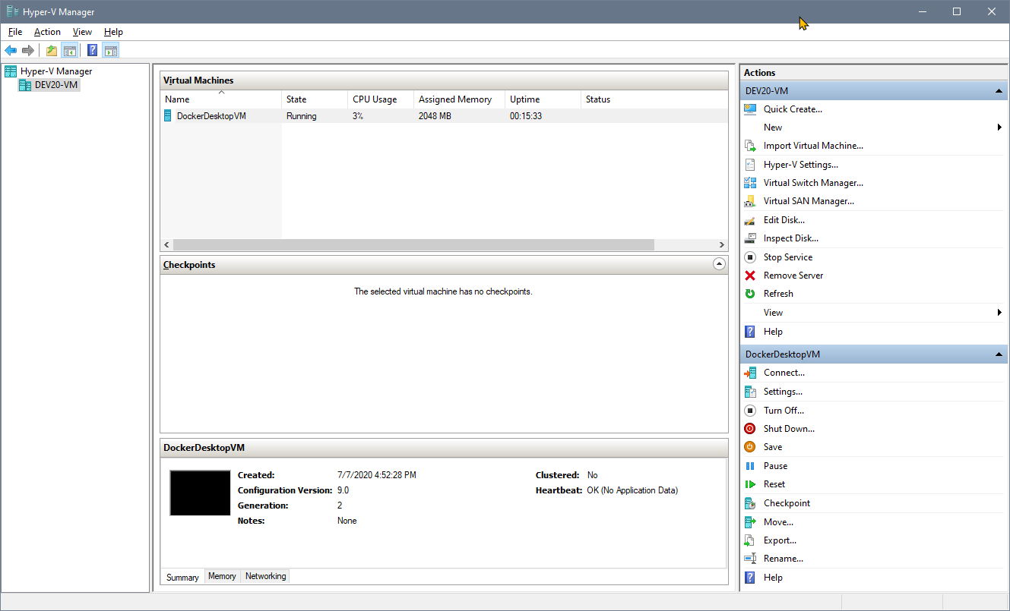

Slide 5
What we will do
Pull a .NET Core image
Create a container from it
Manipulate the image inside of the container
Create a new image from that to distribute

Slide 6
Main command
docker
docker version

Slide 7
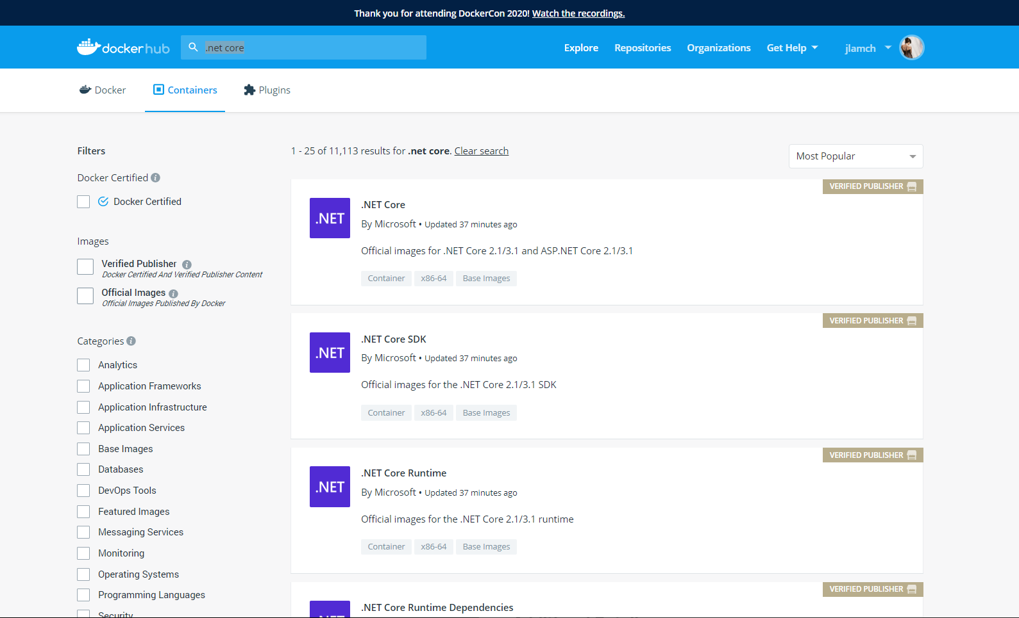

Slide 8
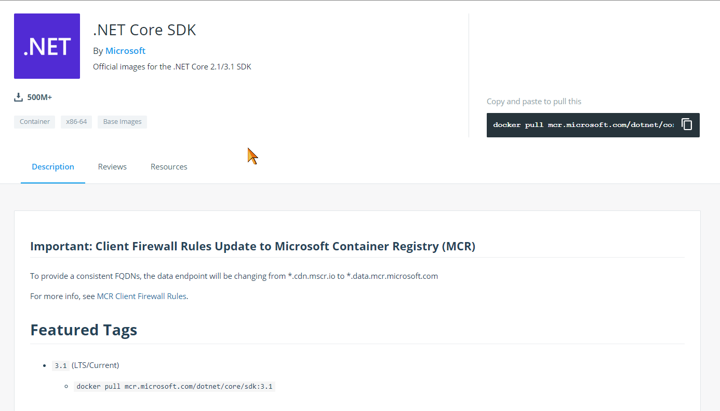
docker pull

Slide 9
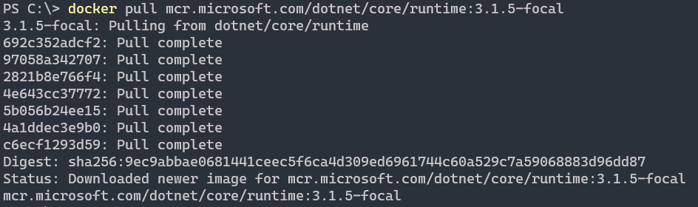
.net core runtime on Ubuntu 20
docker pull „desired.image”

Slide 10
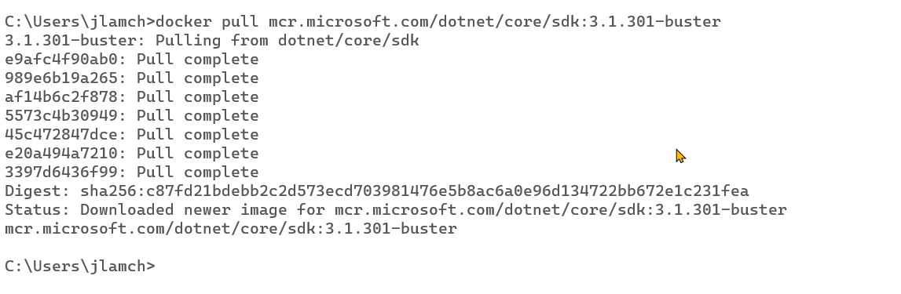
docker pull .net core SDK on debian
docker pull „desired.image”

Slide 11
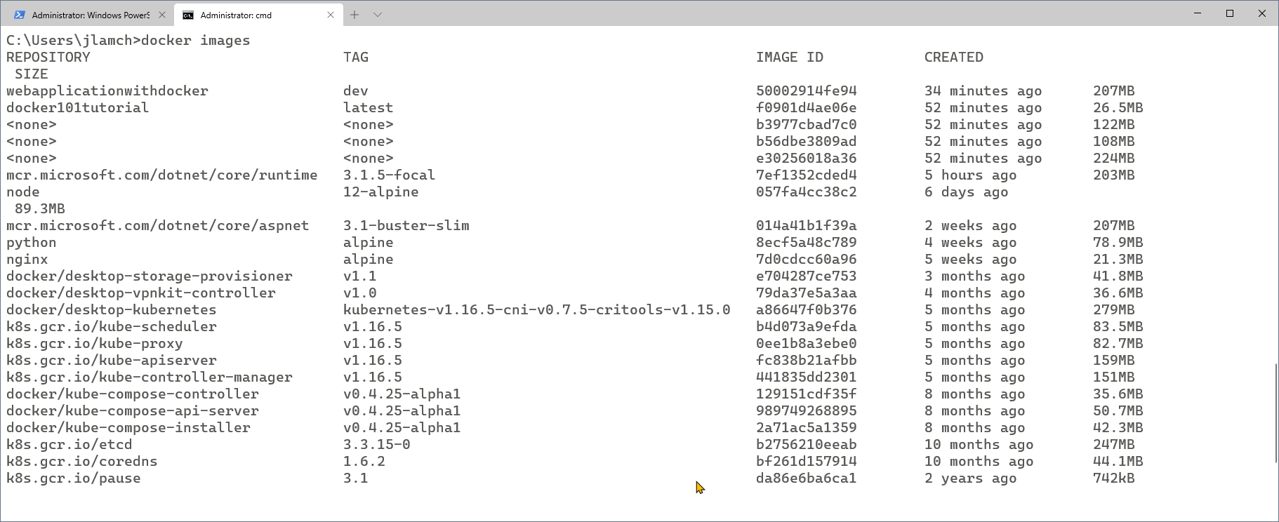
List available images
docker images

Slide 12
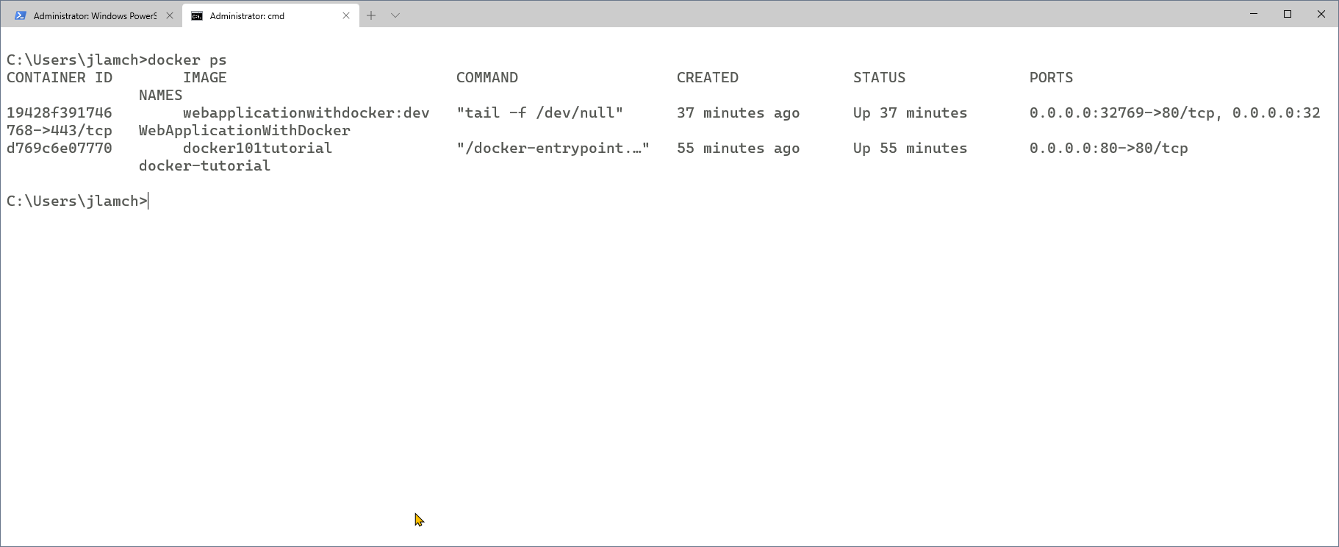
Check running containers
docker ps

Slide 13
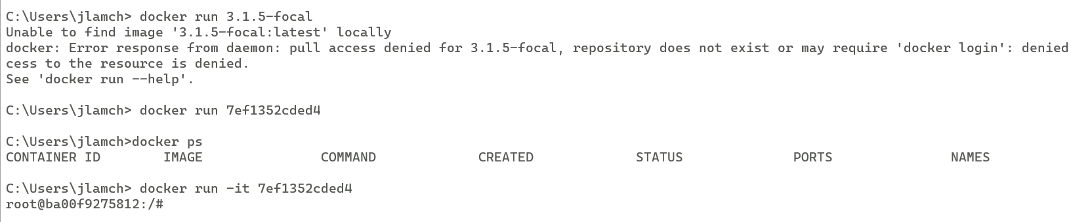
docker run
Notes:
-it -> wchodzimy do konsoli
Jak tylko wychodzimy z konsoli od razu zamyka się proces

Slide 14
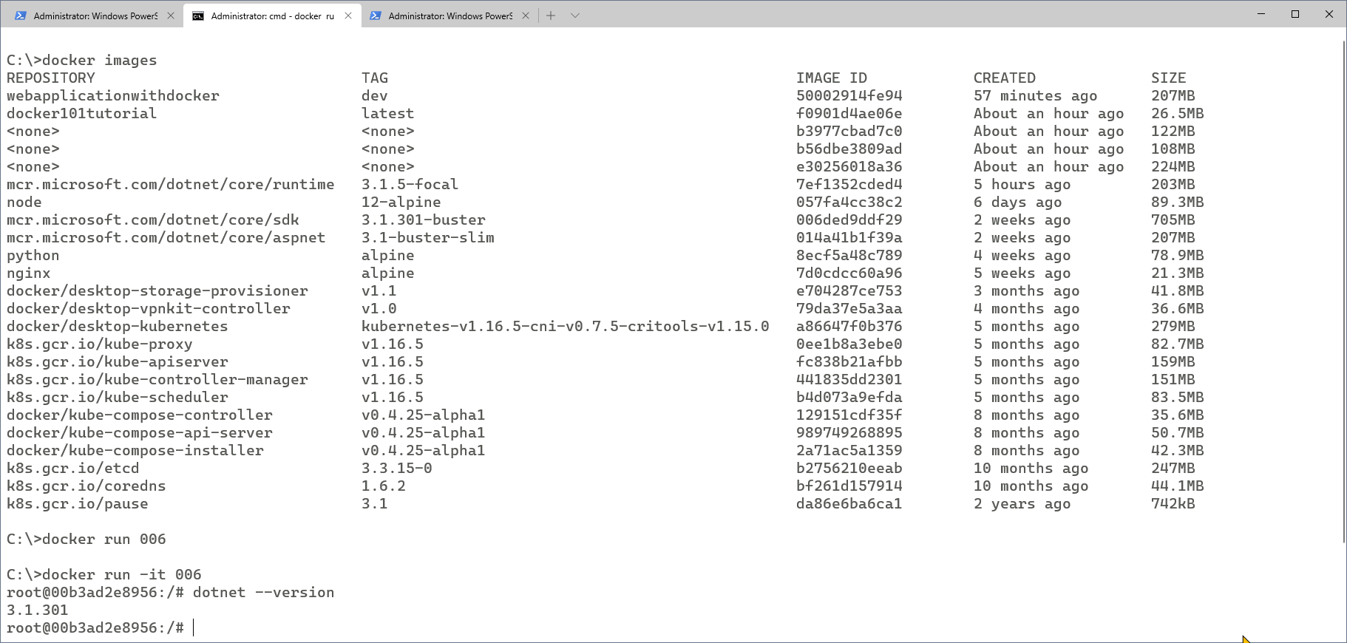
docker run .net SDK image

Slide 15
Run container with terminal and port binding
docker run -it -p 0.0.0.0:5001:5001 imageId

Slide 16
Create app in docker directly
dotnet //check options
dotnet --version //check installed version
dotnet new webapi -h //check possiblities
dotnet new sln -n Workshop
dotnet new webapi -n Workshop.Api
dotnet sln add Workshop.Api
dotnet sln list
dotnet restore
cd Workshop.Api
dotnet run --urls "http://0.0.0.0:80"
https://localhost:80/weatherforecast
ctrl+ c
dotnet add Workshop.Api.csproj package Swashbuckle
dotnet add Workshop.Api.csproj package Swashbuckle --version 5.6.0

Slide 17
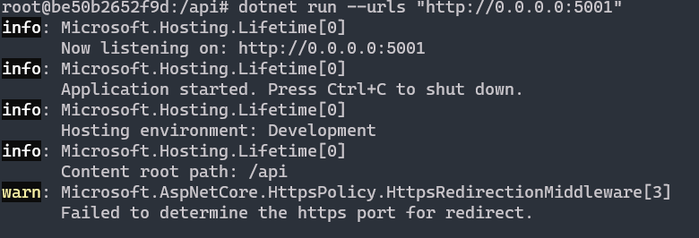
dotnet run --urls "http://localhost:5100"

Slide 18
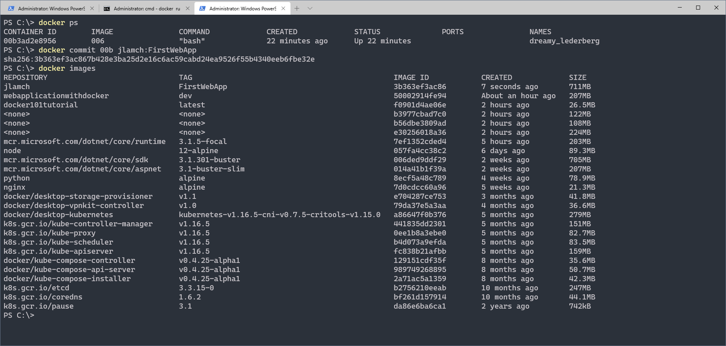
Make some changes and save as new image

Slide 19
Docker with Visual Studio and Docker Hub
Notes:
So what is .NET?

Slide 20
Add docker to WebApi project
Add docker
See docker file
Add controller names
Run API in docker
public IEnumerable<string> Get()
{
return new[] { Environment.MachineName };
}

Slide 21
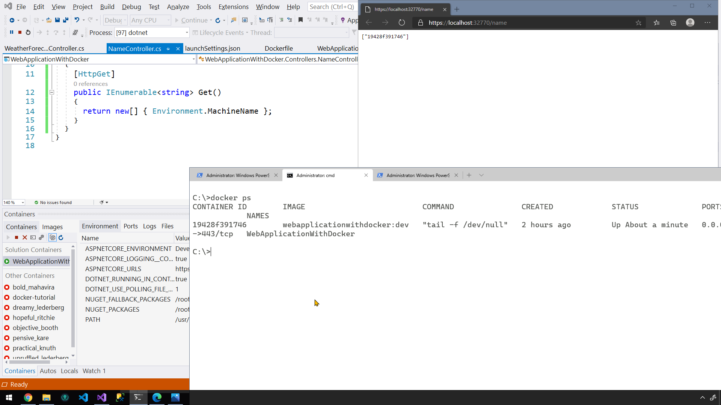

Slide 22
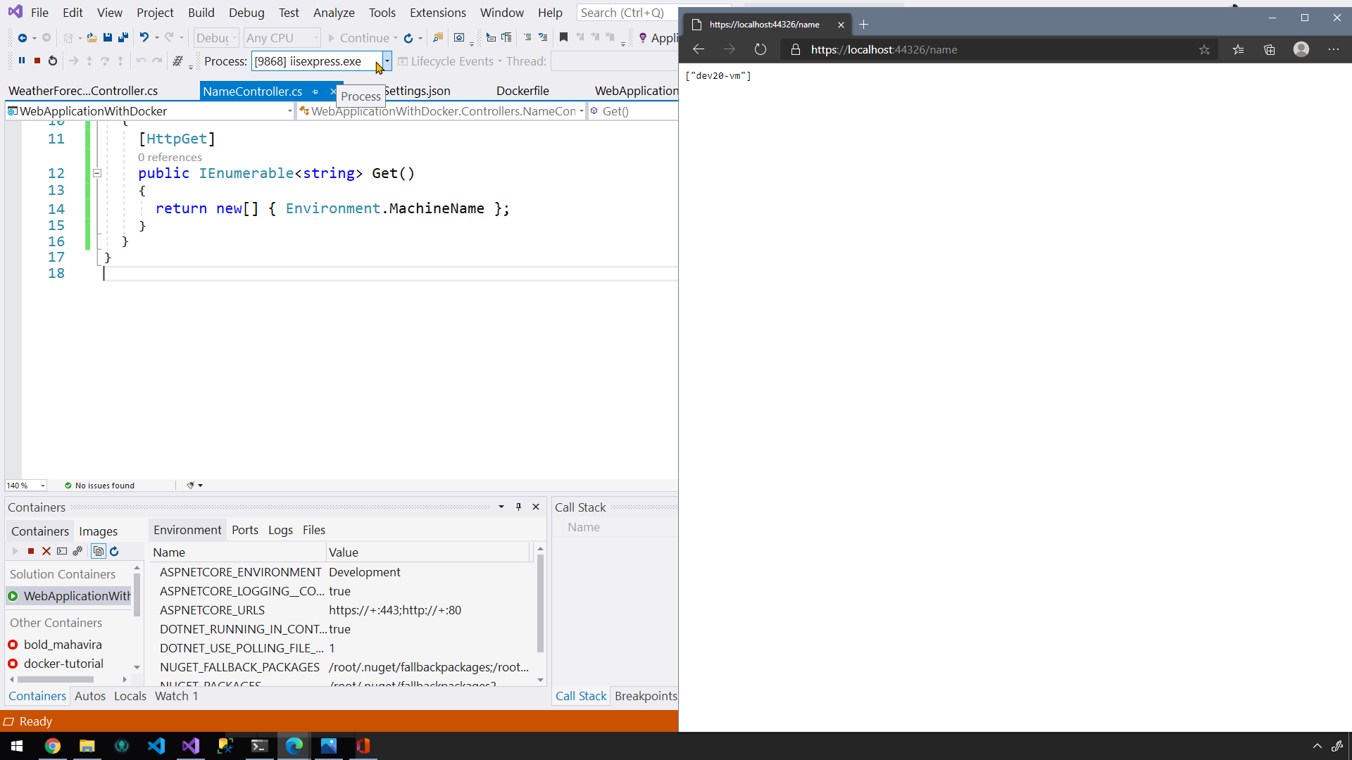

Slide 23
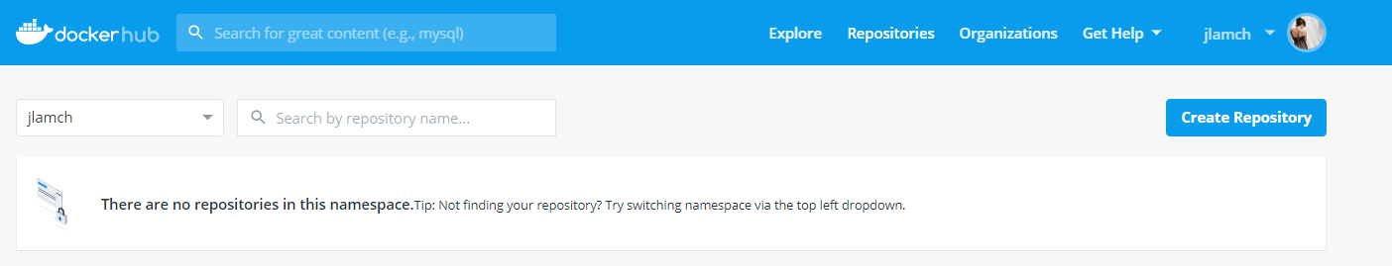
docker push
Login to Docker Hub
Create Docker Hub repository

Slide 24
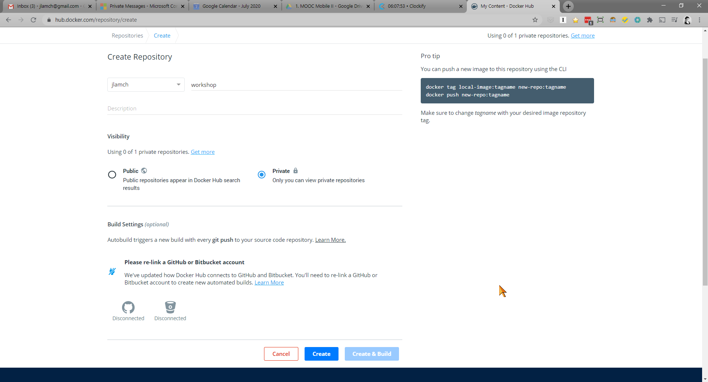

Slide 25
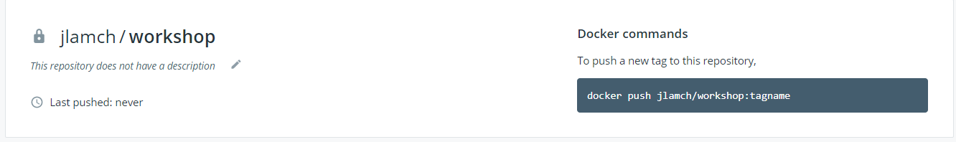
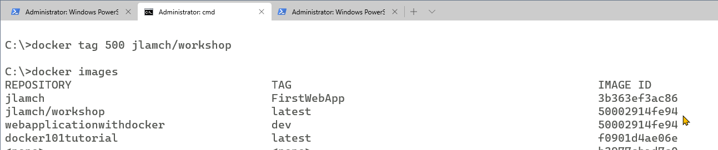
add tag to your image with your repo name
Docker tag imageID jlamch/workshop

Slide 26
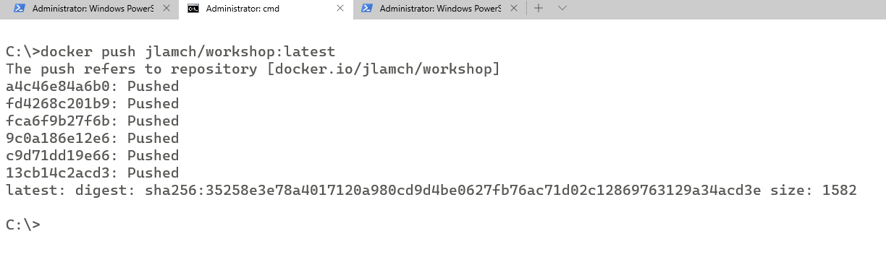
docker push

Slide 27
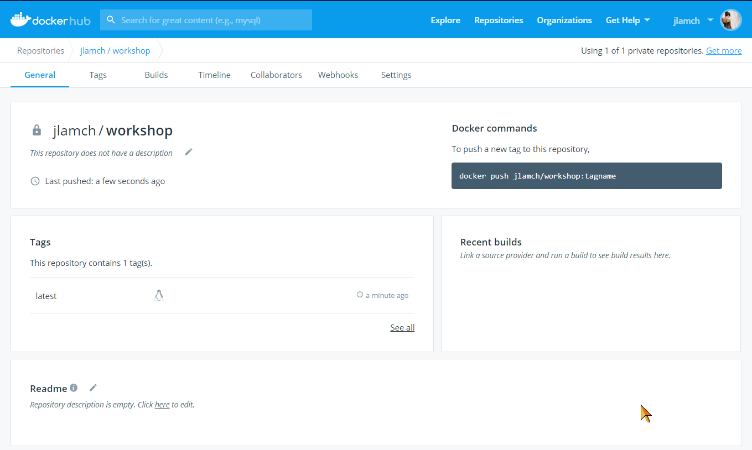

Slide 28
Azure
Notes:
So what is .NET?

Slide 29
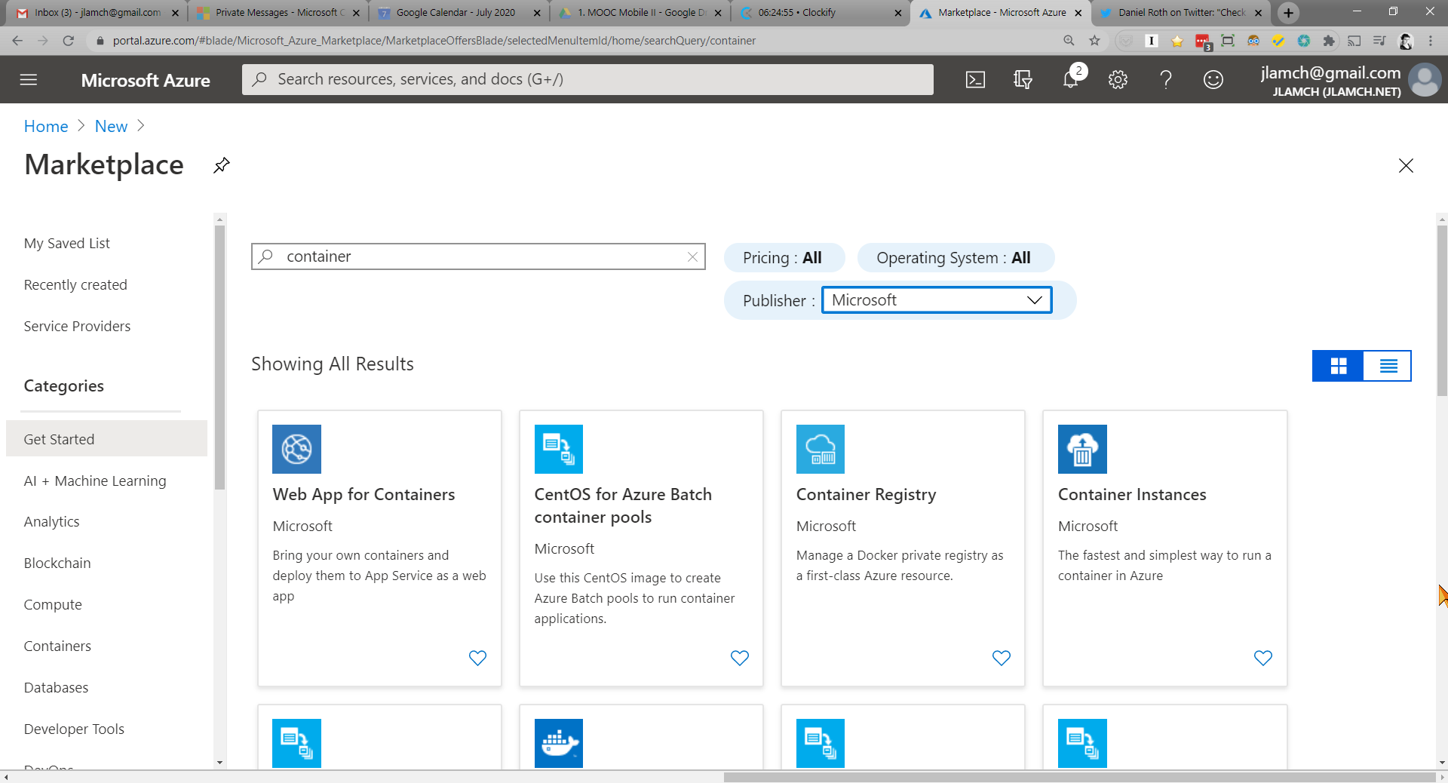
Notes:
Są ECS2 i Fargate to kontenerów
EC2 to takie coś w stylu AppService, wrzucasz tam kontener i sobie chodzi bon stop
Fargate to bardziej jak Container Instances
Bardziej elastyczny bo płacisz za tyle ile używasz
Tak, AWS EKS

Slide 30
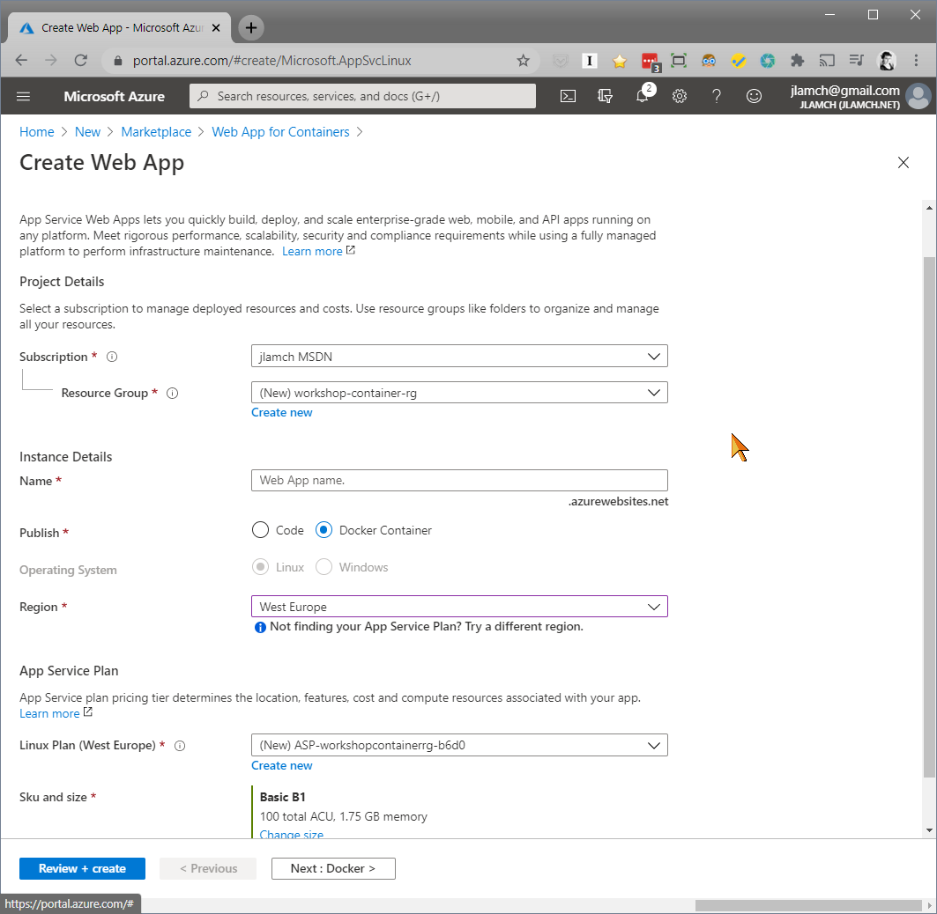

Slide 31
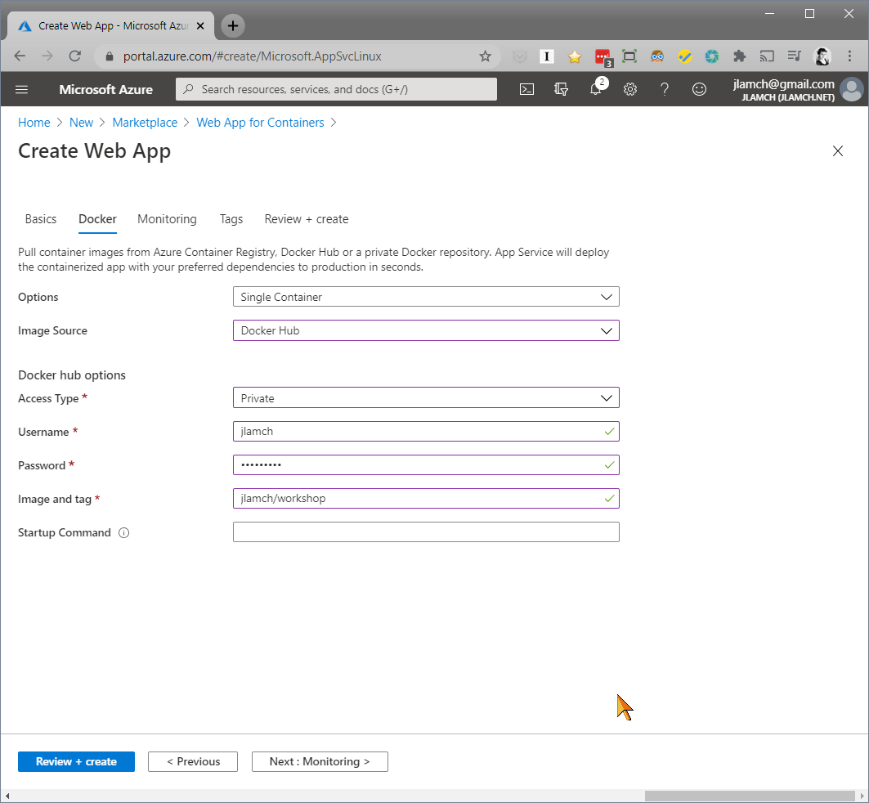

Slide 32
Prepare image once again
Set configuration to release
Remove HttpsRedirect form startup
Remove image
docker rmi xxx –f
Add tag
Push image
Notes:
Dalej CD z docker huba przez web hook
Dalej CICD. Ale juz nie daje rady

Slide 33
Self-hosted docker registry
https://github.com/g0t4/course-implementing-self-hosted-docker-registry

Slide 34
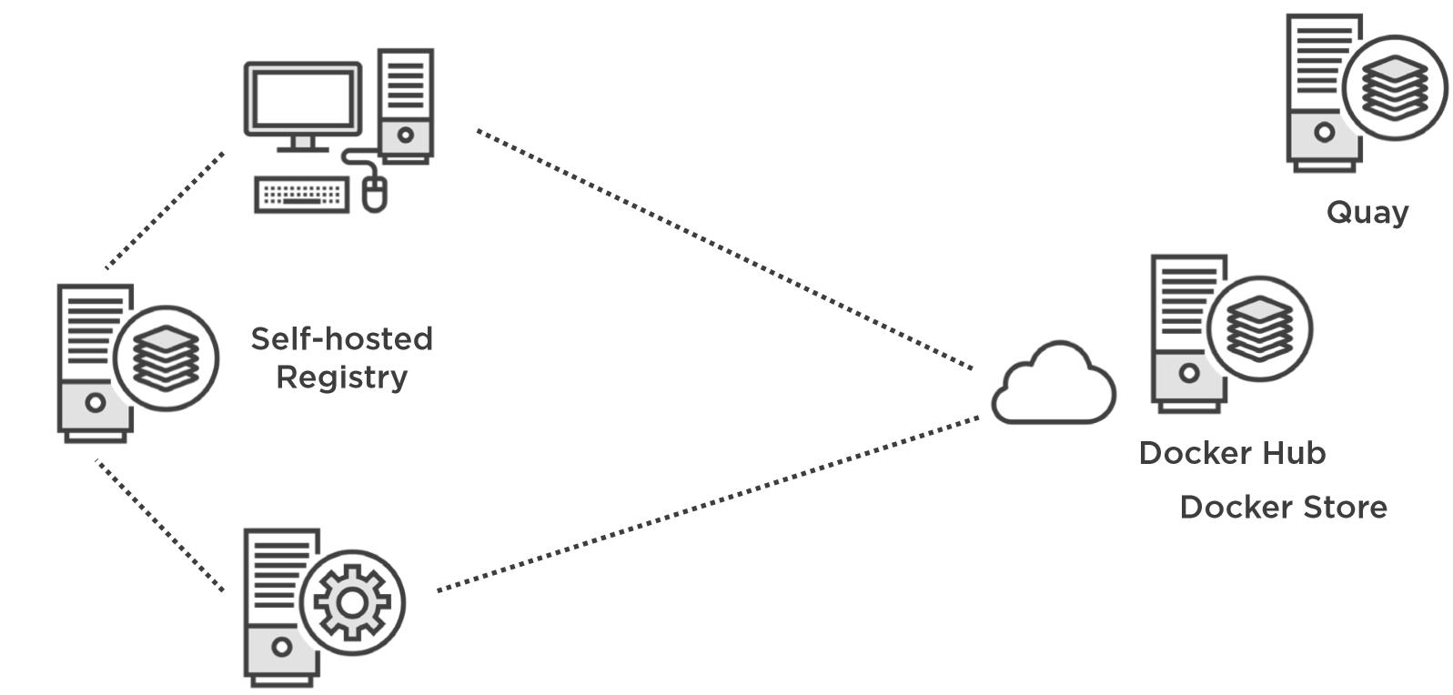

Slide 35
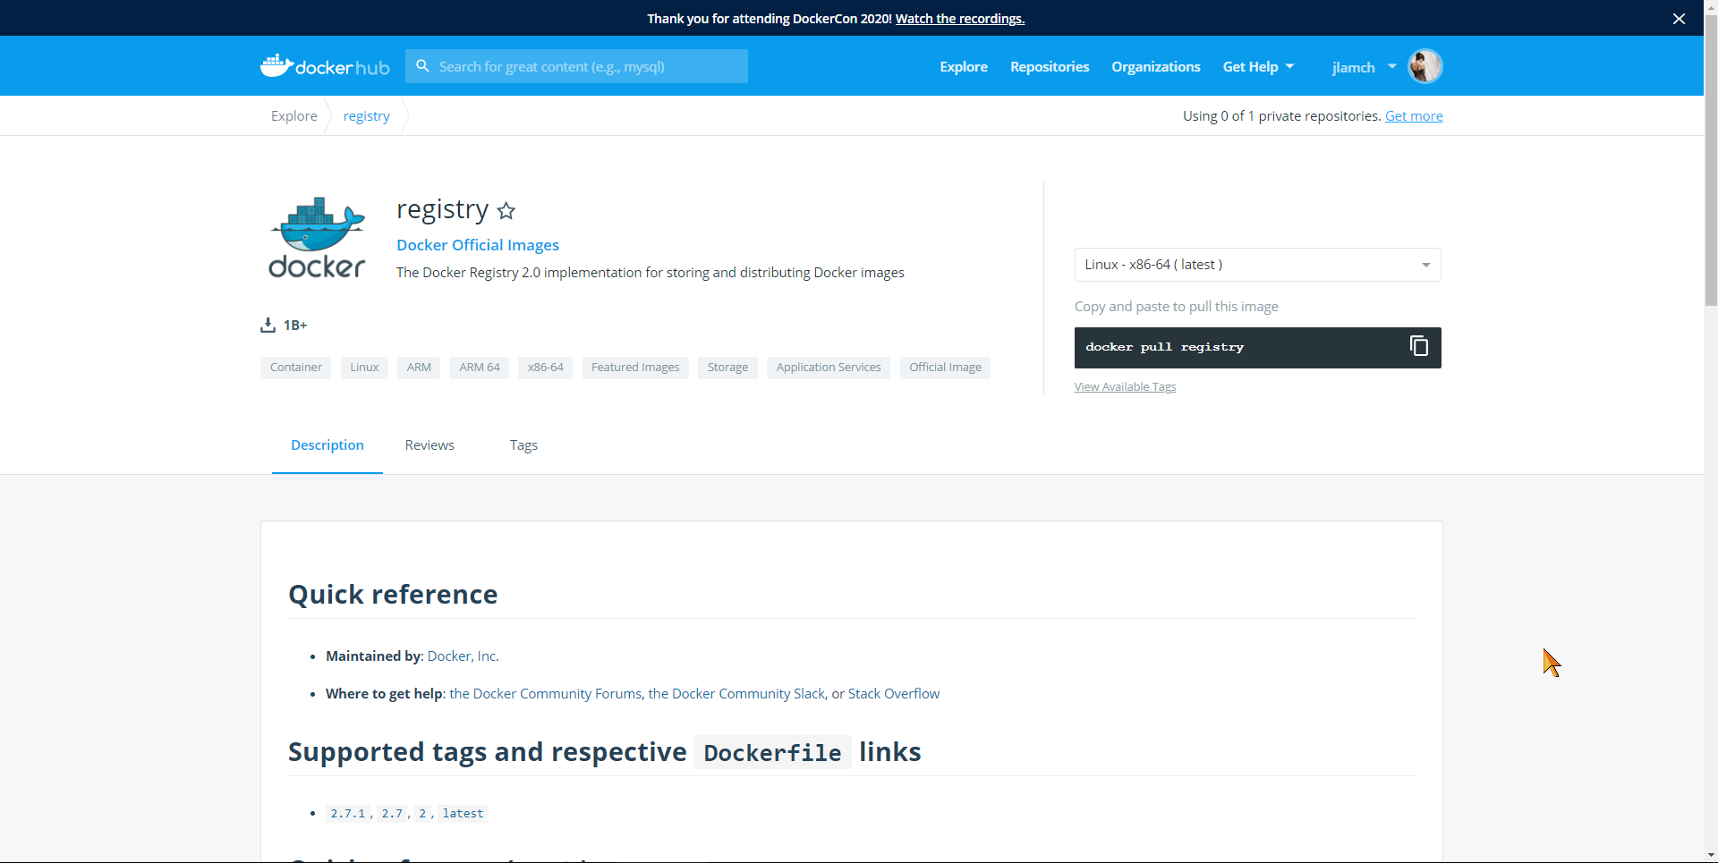

Slide 36
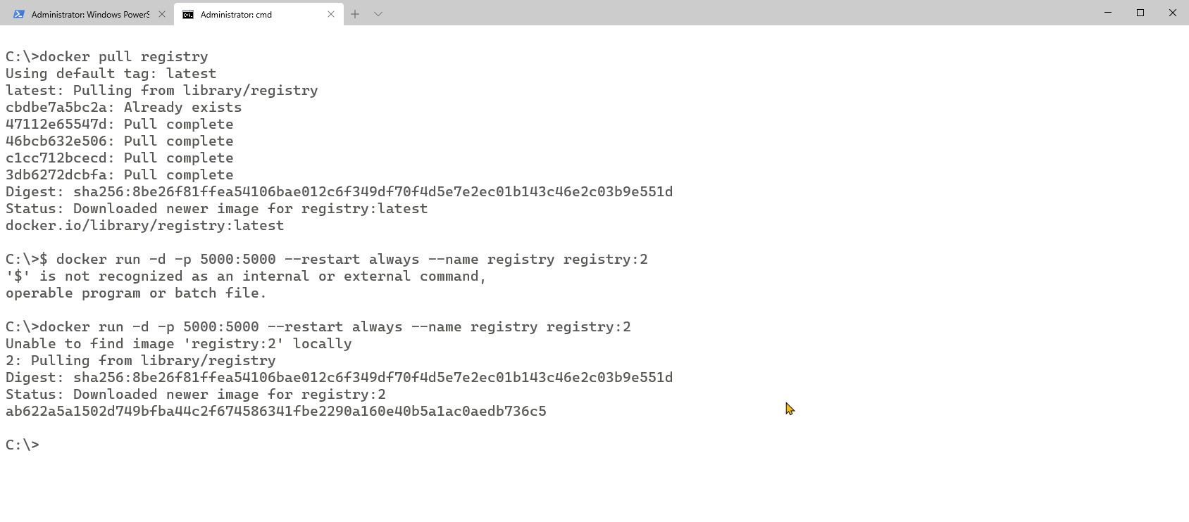
https://github.com/Kymeric/DockerProxy

Slide 37
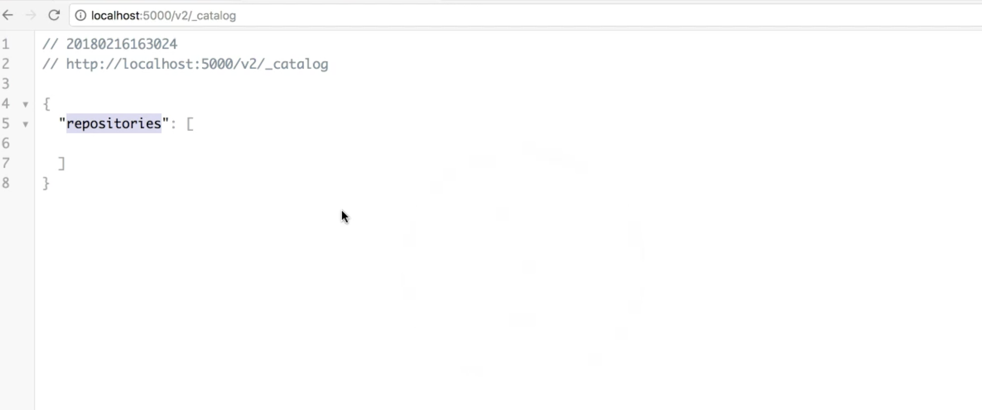

Slide 38
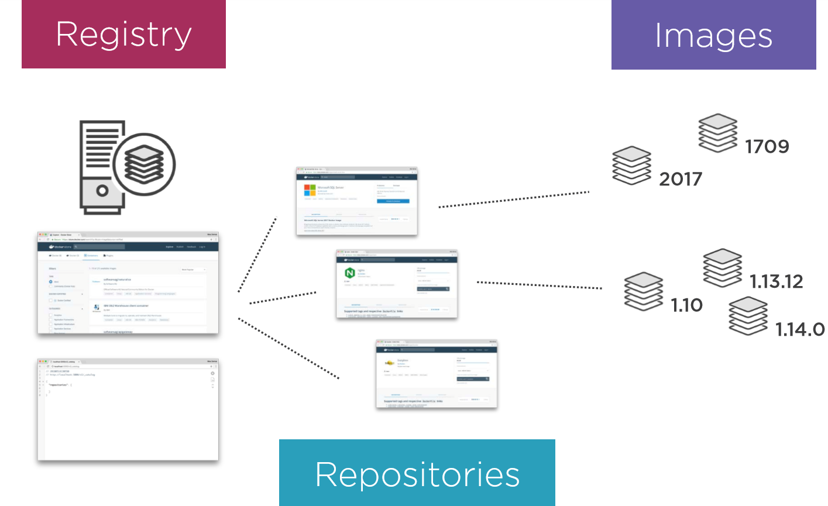
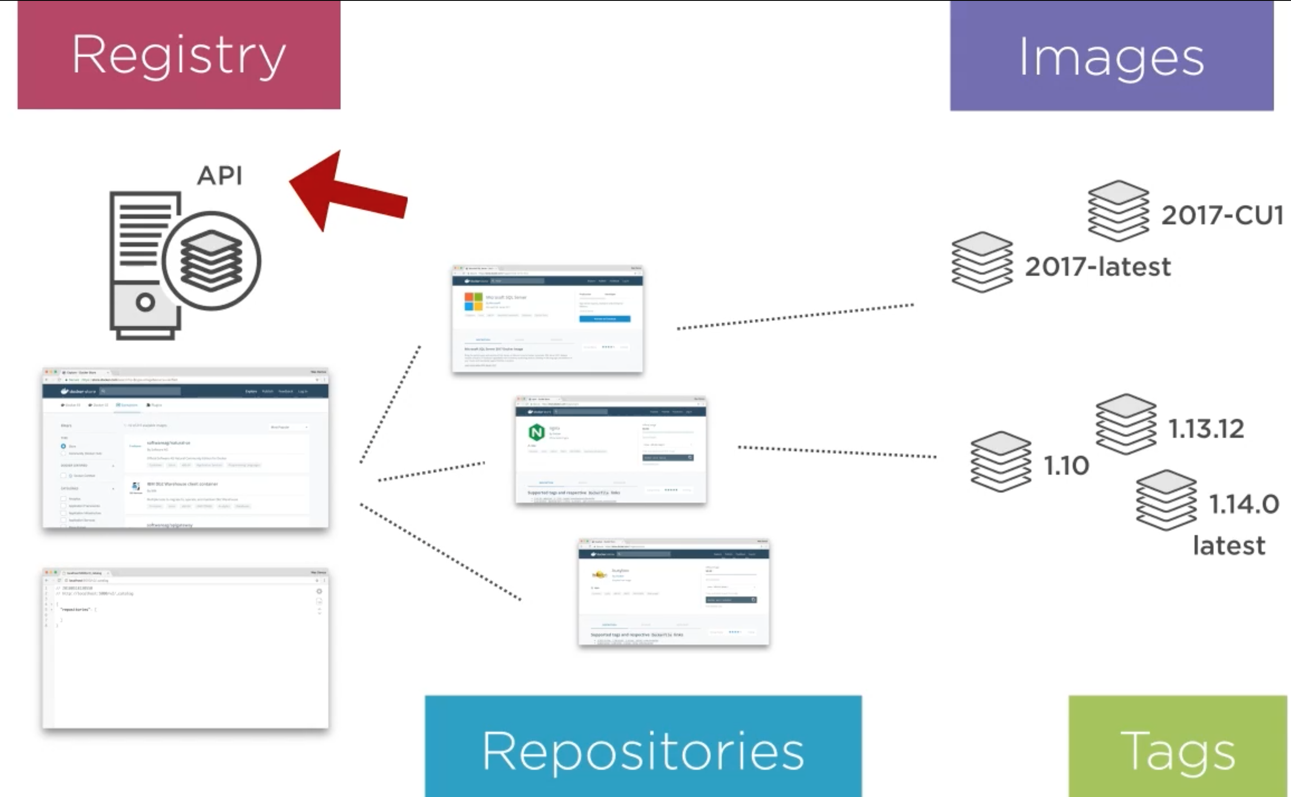
Notes:
nie ma rules jakie maja byc tagi. ale ogolnie rozne tagi (wersje) zawsze sa w danym repo – wiele images w repo

Slide 39
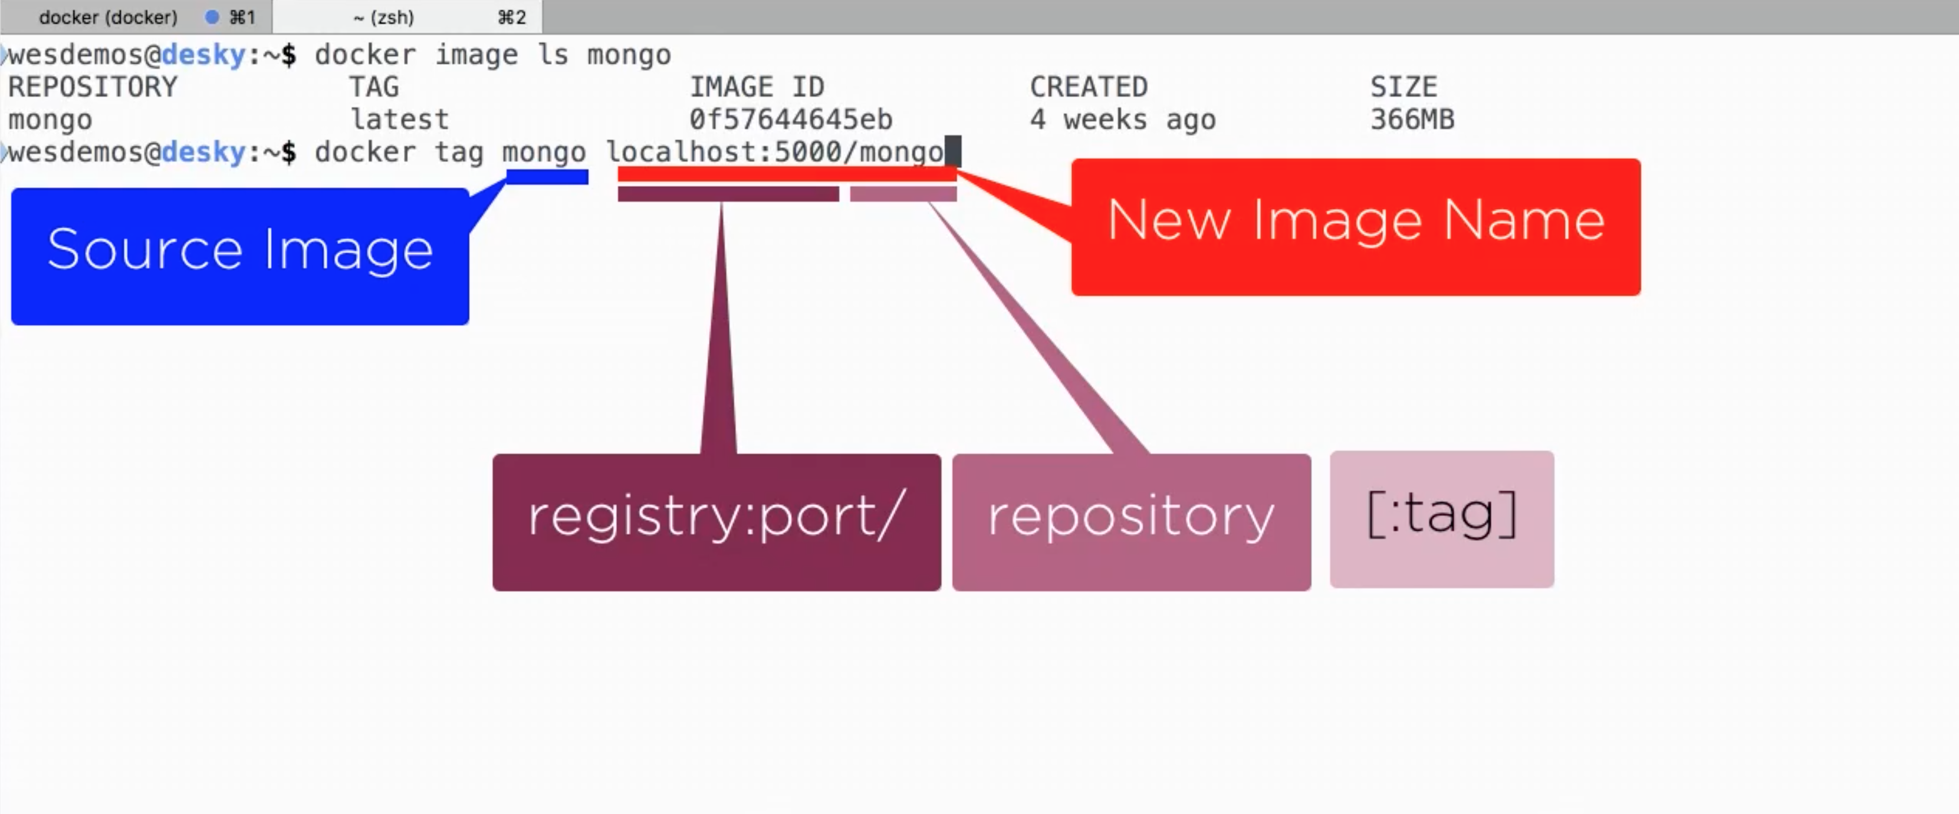
Notes:
potem docker info – I bedzie widac unsecure registry
mozna go wystawic dalej na swiat I mamy lokalne repozytorium

